Slide 1
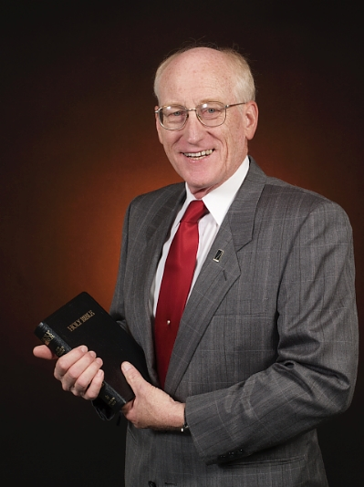
GraceMode
Welcome to GraceMode , featuring the ministry of Rev. Al Dagel, evangelist, Bible teacher and host
of the popular daily devotioncast,
Moments of Grace.
Pastor Al Dagel
Evangelist and host of
Moments of Grace
GraceMode

Slide 2
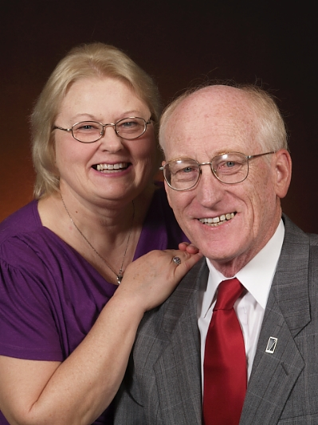
Moments of Grace
Find Moments of Grace on the web any time, day or night at
http://gcbc.podomatic.com
Each day, our host, Pastor Al Dagel, brings a new “devotioncast” to the World Wide Web. These excursions into God’s Word are designed to challenge, bless and comfort you, as Pastor Al brings opens the Word of God and helps us make sense of how the we can both know and serve the Lord in our daily adventure, called “life”.
Pastor Al is joined by his wife of over forty years, who serves as our announcer.
Pastor Al and Eloise Dagel
You can reach Pastor Al by e-mail at
1gracemode@gmail.com
or by mail at
GraceMode
2216 West Street
Pueblo, CO 81003-1816
GraceMode

Slide 3
Pastor Al Dagel is available for pulpit supply, special meetings and more. He has served as a missionary, children’s pastor, youth pastor and senior pastor in several churches in Colorado. He has a passion for evangelism and for helping people know and understand the role of the Bible in daily life.
Our Host and Speaker
You can reach Pastor Al at
1gracemode@gmail.com
or
GraceMode
2216 West Street
Pueblo, CO 81003-1816 (719) 406-0627
GraceMode

Slide 4
What it takes to bring you Moments of Grace…
Of course, there are some expenses involved in producing a daily podcast, but we have done well in keeping those expenses at a minimum.
Pastor Al Dagel has used his own electronics, computers, microphones and sound gear, etc.. We do pay a monthly fee for internet service and one for our place on PodOmatic, the home of the devotioncast.
Pastor Al is also actively promoting the ministry of GraceMode, and that may take any or all of the following resources: mileage, related expenses for travel, promotional materials, web hosting and the like.
We have made it possible for listeners and supporters to donate to GraceMode via PayPal. Our fund raising will be low-keyed, because we want only to serve. Pastor Al does not receive a salary from this ministry. Checks are also welcome.
GraceMode

Slide 5
Links we like:
Pastor Al Dagel’s business site
Focus on the Family
Promise Keepers
Moments of Grace
GraceMode

